Slide 1






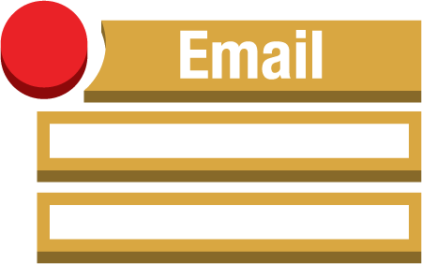



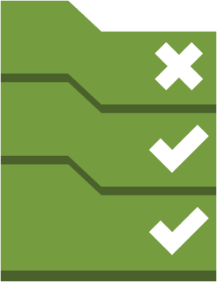
AWS-Region
S3
(encrypted with KMS)
Cloudtrail
Delivered to CloudWatch Logs
Alarms
Amazon CloudWatch
SNS
Email Notification
Event Rules
Custom Lambda functions
Custom Config rules
Lambda functions
Config Rules
Config
Managed
Config rules

